Slide 1
The term “4G”
Is It Real or Fake?

Slide 2
Stance:
The term “4G’ is a marketing ploy to increase consumer demand.

Slide 3
History of Communication
3500 to 2900BC- The Phoenicians develop the alphabets.
1450- Newspapers appeared in Europe.
1898- First telephone answering machines.
1914- First cross continental telephone call made.

Slide 4
History of Cell phones
1973- Dr. Martin Cooper invents the first personal handset while working for Motorola.
1979- First cellular phone communication network started in Japan.
1988- The Cellular Technology Industry Association is created and helps to make the industry into an empire.
1999-First introduction of Mobile Web
2007- Apple Releases the I-Phone

Slide 5
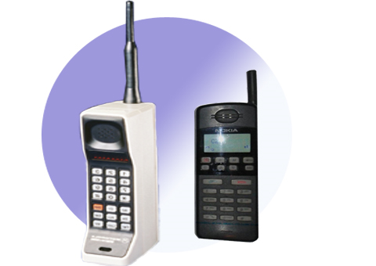
First Generation “1G”
What is “1G” ?
1st generation of wireless telecommunication technology (EST.1983)
Replaced 0G technology, which was used for radio telephones
Used analog radio signals, rather than digital signals

Slide 6
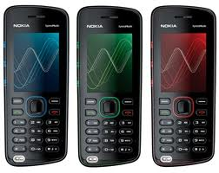
Second Generation “2G”
What is “2G”?
EST.1990’s
This generation used digital circuit switched transmissions.
2G, enabled quicker network signaling, which lowered the amount of drop calls.
The phones of this generation, were less bulkier, and were not in-need of large batteries

Slide 7
Third Generation “3G”
What is “3G”?
This generation is the most effective generation today.
Includes at least 2 megabits of data indoors and 384 Kbits for outdoor use.
Enables emails, internet access, as well as Wi-Fi.

Slide 8
Fourth Generation “4G”
“4G” expected to:
Enable simultaneous connections to mobile high-speed networks
Allow extremely high downlink connections, both indoors and outdoors.
Provide high-efficiency, high-speed packet transmissions for the uplink.
Supporting of the Forward Error Correction, which allows much larger data packets to be transmitted at the same time, reducing the bit error rate..

Slide 9
The Issue
4G networks are not meeting , its stated requirements.
Some companies are now using what is called 3.9G.
Marketers are using this to their advantages and labeling it 4
http://www.youtube.com/watch?v=M4JffLcyKVA

Slide 10
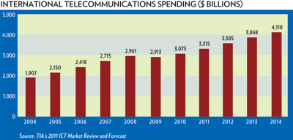
Economic issues

Slide 11
Economic Issues
Telecommunications are spending billions on the cellular industry.
In 2009 Smart phones accounted for 172.4 million of the 1.211 billion mobile phones sold that year. This was 23.8% more Smartphone sales than in 2008.

Slide 12
Cultural Issues
We are becoming to dependent upon cell phones, yet alone technology.

Slide 13
Moral Issues
Society has accepted the term “4G”, without using moral judgment.

Slide 14
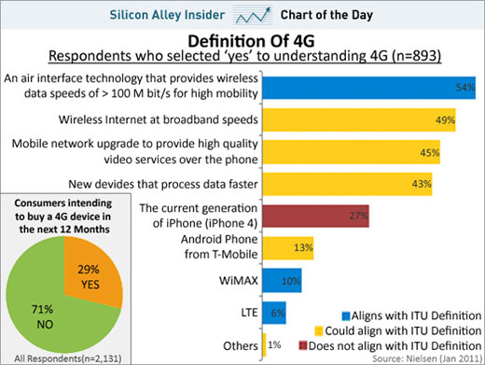
Potential Solutions
Becoming familiar with the term “4G”
If we have knowledge of what we are consuming, maybe marketers would sell us the truth.

Slide 15
Future Implications
3G phone shipments in China rose to 35.96 million units in 2009.
Over 500 million smart phones will be available for consumers by 2012

Slide 16
My Positions
If we become knowledgeable of what we are consuming, rather than keeping up with the latest technology, marketers would consider selling society the truth.
If we continue to desire better generations of cell phone or any other types of high-end technology, the world could become highly toxic

Slide 17
GOING HI-TECH IS HIGHLY TOXIC
QUOTE:
“Every year, hundreds of thousands of old computers and cell phones are dumped in landfills or burned in smelters. Thousands more are exported, often illegally, to Asia, where workers at scrap yards, often children, are exposed to a cocktail of toxic chemicals and poisons” (Greenpeace, 2009)

Slide 18
References
Jun-swok Hwang, Roy R. Consulta & Htun-young Yoon, (2010). 4G Mobile Networks-Technology Beyond 2.5G and 3G.
Keith Robert (2004). The Cell Phone Timeline
http://iml.jou.ufl.edu/projects/fall04/keith/history1.htm
Kwan Michael (2011). Cell Phone Timeline
http://cellphones.lovetoknow.com/CellularPhoneTimeline
Ian Akyildiz, David Estevez, Elias Reyes, (2010). The evolution to 4G cellular systems: LTE-Advanced

Slide 19
References (Cont.)
Telephone Tribute, Timeline of Telecommunication.
www.telephonetribute.com/timeline.html
TIA’s 2011 ICT Market Review & Forecast (2009). http://www.tiaonline.org/market_intelligence/mrf/index_MRF_page_4.cfm

